Slide 1
Introduction to Healthcare Stock (Procter & Gamble Co)
Machine Learning & Python in Finance

Slide 2
P&G Introduction
The Procter & Gamble Company is an American multinational consumer goods & healthcare corporation headquartered in Cincinnati, Ohio, founded in 1837 by William Procter and James Gamble.
Procter & Gamble is making a stronger push into DIY healthcare with more products aimed at consumers looking into wellness options, observes The Wall Street Journal's Sharon Terlep.
The company is also using its venture arm to partner on new online healthcare brands.

Slide 3
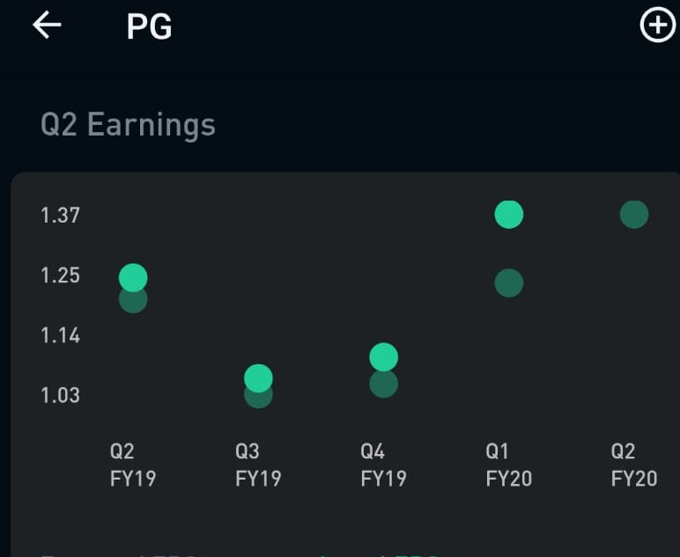
Why P&G?
2nd largest market cap in Healthcare with $314 Billion
Dividend yield per share: $2.39
Price-Earnings Ratio: 83.13
52 week high: $127 (achieved yesterday)
P&G (39.47%) outperformed S&P 500 (24.19%) in a year
Quarterly earning graph
91% Analyst Rating for Buy and Hold

Slide 4
Team
Parth Rana
(Past intern at State Street in Quantitative Finance Research)
Shaishav Shah
(Past intern at Recorded Future in Product Analytics)
Looking for people who has intuition in Finance

